Slide 1



Apprenticeship Illinois
Bootcamp
August 2023

Slide 2
Welcome
From dceo & dol
Debra Cremeens-Risinger
Annie Dorr
Kelly Lapetino, Ed.D.
Bryan Ellis
Notes:
Set tone! ---
Peer learning – active learners, share experience
All 4 Introduce themselves, their organization and regions, and welcome everyone

Slide 3
Registered apprenticeship in Illinois
  Illinois is an “OA” state w/Director & 4 ATRs
  19,664 Registered Apprentices
  422 Registered programs
  6,138 New apprentices between FY 2023
  DOL vision and working with the State

Slide 4
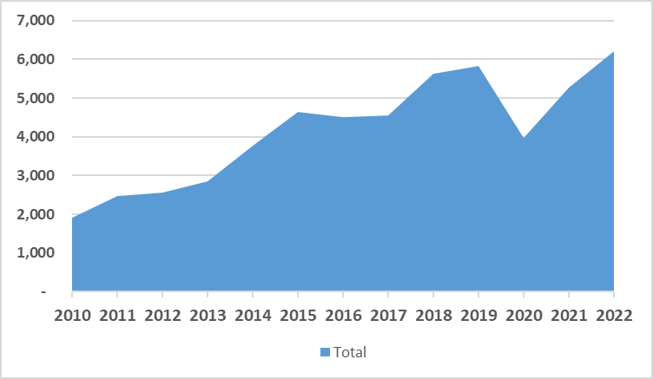
Registered apprenticeship in IL
Number of New Apprentices is Growing each Year
Notes:
Deb – Jen work with Deb

Slide 5
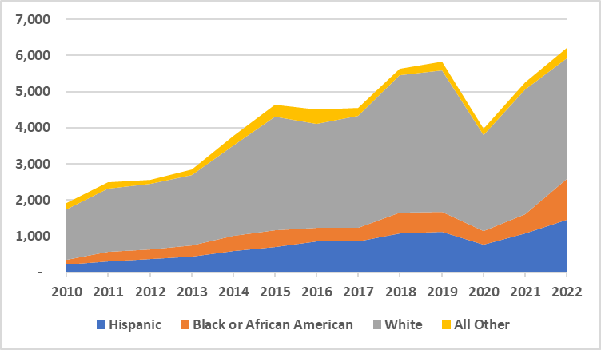
Registered apprenticeship in IL
Number of New Diverse Apprentices is Growing each Year
Notes:
Deb – Jen work with Deb

Slide 6
Registered apprenticeship in IL
Number of New Apprentices by Year – Growing
Notes:
Deb – Jen work with Deb

Slide 7
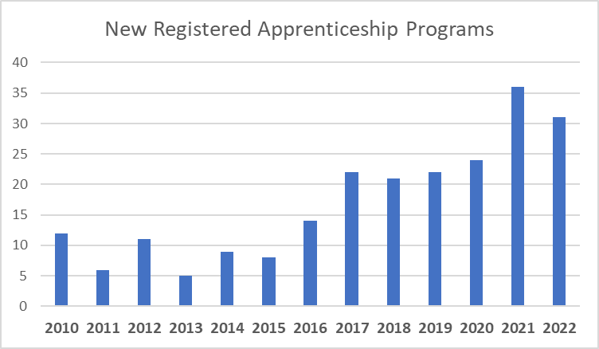
Registered apprenticeship in IL
Number of New Programs in Illinois is Growing
Notes:
Deb – Jen work with Deb

Slide 8
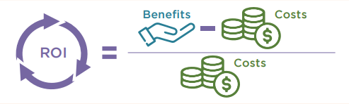
Benefits for employers
  Registered Apprenticeship programs offer access to hundreds of occupations, in high-growth and emerging industries.
  90% Retention Rate - Percentage of apprentices who retain employment after apprenticeship completion
  Skilled Workforce
  Improve Productivity
  Reduced Turnover
  Foster Diversity
Notes:
Deb – Jen work with Deb

Slide 9
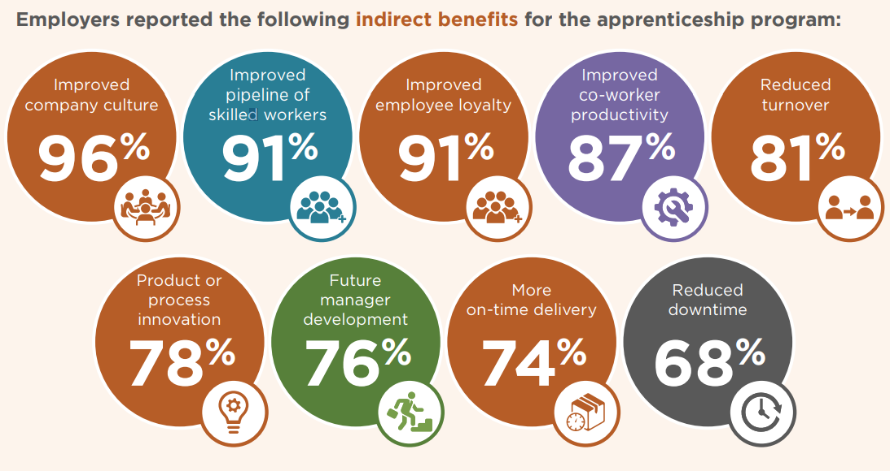
Benefits for employers
Notes:
Deb – Jen work with Deb

Slide 10
US DOL Award
DCEO issued entire $1.3 M in US DOL Apprenticeship Expansion Grant funds
11 applications received
    LWIAs 1, 3, 4, 6, 7, 13, 14, 15, 17, 23, and 25.
    LWIAs 22 and 24 using remaining funding within current Navigator grant to perform same activities as new grantees
    Working with all LWIAs, not just grantees
Period of Performance July 1, 2023-June 30, 2024
Anticipate recurring formula funding annually

Slide 11

5-year state apprenticeship plan
Detailed, five-year State plan required by US DOL
Aligned with State Unified Plan
Structured around 5 goals
  Need Operational Elements– Commit to activities for next 5 yrs
Stakeholders include IWIB Apprenticeship Committee, core WIOA partners, ISBE, community colleges, CBOs, and YOU
State will apply for a competitive Apprenticeship Expansion grant for up to $6 million
Notes:
What strategies and activities should we include over the next five years to expand apprenticeship?

Slide 12

Apprenticeship 2.0
  Navigator function LARGER than one person
  Integrating apprenticeship & WBL into local workforce boards
  Integrated Business Service Teams (IBST) understand how apprenticeship or WBL helps employers
  Apprenticeship Specialists working with IBST, LWIBs, and other workforce, education, and economic development partners through intentional coordination

Slide 13
Apprenticeship 2.0
OUTREACH: Serve as a point of contact to assist in the development of apprenticeship and work-based learning opportunities
PARTNER COORDINATION: Support the regional coordination of apprenticeship and work-based learning opportunities with employers and workforce / education / economic development partners.
DIRECT ASSISTANCE IN DEVLOPING APPRENTICESHIPS: Serve as a subject matter expert to facilitate the establishment of an apprenticeship program based on the needs of the employer.
Notes:
These teams will build and support industry sector strategies among employers and the workforce, education, and economic development partners

Slide 14
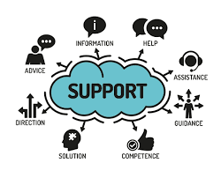
Apprenticeship Illinois team
  DOL OA Team – Director & 4 ATRs
    Debra Cremeens-Risinger – Director
    Bruce Hallam – ATR
    Nakeya Womack – ATR
    Meredith Thetford – ATR
    Marlene Budge – ATR
  3 DCEO OET Regional Managers
    Bryan Ellis – Southern Regional Manager
    Annamarie Dorr – Central Regional Manager
    Kelly Lapetino, Ed.D. – Northern Regional Manager

Slide 15
Apprenticeship Illinois team
  Chase Martin – Grant Manager
  Nate Carlson – State Apprenticeship Mentor
  Candace Dickerson – State Apprenticeship Delegate & Program Technical Assistance Manager
  Kim Kuchenbrod – Talent Pipeline Management
  Tanner Crawford - Lead Staff - IWIB Apprenticeship Committee
  Jennifer Foil – Program Support
  John Barr – DCEO OET Executive Lead
And even more support

Slide 16
Apprenticeship support /
professional development
  Talent Pipeline Management Academy
  Webinars on specific topics, e.g. Funding
  Apprenticeship Illinois Team
  Office hours & Real Time help
  Provide library of existing resources
  Create new resources as needed
  Efforts scale – Illinois Works, CEJA, JTED, WIOA

Slide 17
A pep talk from kid president to you
https://www.youtube.com/watch?v=l-gQLqv9f4o

Slide 18


Notes:
We can answer common questions

