Slide 1
Apprenticeship Illinois
Bootcamp
July 2021

Slide 2
APPRENTICESHIPS 101: WORK-BASED LEARNING and THE VALUE PROPOSITION
Dr. Justin Arnold
Nate Carlson
Bonnie Moore

Slide 3
Covered in this session
Work-Based Learning
Outcomes for Employers & Apprentices
Examples of using WIOA funding for WBL

Slide 4
What is WBL?
Illinois Career Pathways Dictionary
Learning that provides participants with work-based opportunities to practice and enhance the skills and knowledge gained in their program of study or industry training program, as well as to develop employability.
Notes:
According to the IL Career Pathways dictionary, WBL is defined as : learning that provides participants with work-based opportunities to practice and enhance the skills and knowledge gained in their program of study or industry training program, as well as to develop employability, and it includes an assessment and recognition of acquired knowledge and skills. Examples include: internships, service learning, paid work experience, on-the-job training, incumbent worker training, transitional jobs, and apprenticeships (do we want to add any of these to the PPT?
(WBL should be integrated with classroom learning to help participants draw connections between coursework and future careers.)

Slide 5
Examples of WBL
Customized Training
Incumbent Worker Training
On-the-Job Training
Job Shadowing
Clinical Experiences
Cooperative Learning
Mentorships
Internships/Externships
Apprenticeships
Notes:
According to the IL Career Pathways dictionary, WBL is defined as : learning that provides participants with work-based opportunities to practice and enhance the skills and knowledge gained in their program of study or industry training program, as well as to develop employability, and it includes an assessment and recognition of acquired knowledge and skills. Examples include: internships, service learning, paid work experience, on-the-job training, incumbent worker training, transitional jobs, and apprenticeships (do we want to add any of these to the PPT?
(WBL should be integrated with classroom learning to help participants draw connections between coursework and future careers.)

Slide 6
WBL Framework: Components of Comprehensive WBL Programs
Notes:
Source—cte.ed.gov/wbltoolkit
This slide gives the framework of WBL and shows the 3 components of effective WBL programs
One- WBL is an instructional strategy that enhances classroom activity by connecting the work completed in the classroom to the experience to be had in the workplace. (These three images will offer more understanding of the WBL strategy, and how to engage employers, collect data, and scale effective programs—saying this is optional)
Two- in order to apply academic, technical and employability skills in a work setting, the WBL experience should be based on a comprehensive academic and employability skill requirements, and should also include in-depth hands-on experiences
Three—Participant should have mentors and these mentors should be trained on how to provide participants with industry-specific support general career and education guidance, personal and professional growth and a caring, emotional connection.
The mentors should support the participant by having the supervisors, instructors, etc. to promote participant engagement and to also monitor their progress and provide evaluations on the participant progress, AND mentors should allow participants to develop relationships with industry and community professionals

Slide 7
What is the Difference between apprenticeships & internships?
Duration
Structure
Mentorship
Payment
Certification
College Credit
Notes:
According to the IL Career Pathways dictionary, WBL is defined as : learning that provides participants with work-based opportunities to practice and enhance the skills and knowledge gained in their program of study or industry training program, as well as to develop employability, and it includes an assessment and recognition of acquired knowledge and skills. Examples include: internships, service learning, paid work experience, on-the-job training, incumbent worker training, transitional jobs, and apprenticeships (do we want to add any of these to the PPT?
(WBL should be integrated with classroom learning to help participants draw connections between coursework and future careers.)

Slide 8
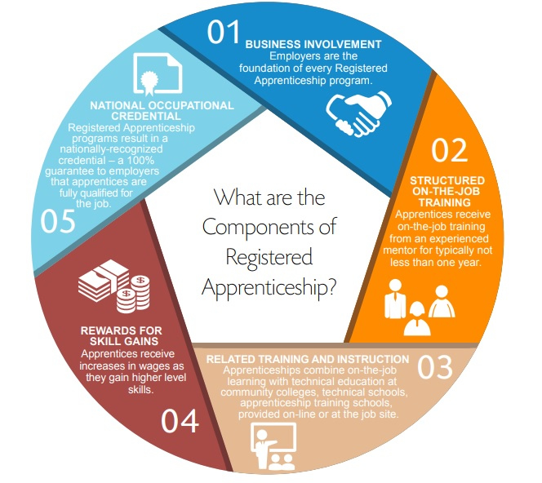
Registered apprenticeship model
Notes:
According to the IL Career Pathways dictionary, WBL is defined as : learning that provides participants with work-based opportunities to practice and enhance the skills and knowledge gained in their program of study or industry training program, as well as to develop employability, and it includes an assessment and recognition of acquired knowledge and skills. Examples include: internships, service learning, paid work experience, on-the-job training, incumbent worker training, transitional jobs, and apprenticeships (do we want to add any of these to the PPT?
(WBL should be integrated with classroom learning to help participants draw connections between coursework and future careers.)

Slide 9
≠
apprenticeships
internships
Longer, 1-4 years
Structured training focusing on mastering specific skills an employer needs
Mentorship required
Paid and continued career path w/employer
Nationally-recognized credential (Registered Apprenticeships)
Will obtain debt-free college credit or employer provided training
Usually, short term 1-3 months
No structured training & often focus on entry-level general work experience
Do not always include mentorship
May be unpaid and may not lead to a full-time job
Typically, no credential
May get college credit
Notes:
Apprenticeships are Earn and Learn Models and apprentices can earn a wage while they are learning necessary skills to be successful in the role.
Apprenticeship are long term 1-3 years and include a structural plan, focusing on mastering specific skills and employer needs to fill an occupation within their organization
Apprentices receive individualized training with an experienced mentor who walks them through their entire process
Apprenticeships lead to an industry-recognized credential
Some apprenticeship programs will lead to debt-free college (college certificates, degrees)
(WBL should be integrated with classroom learning to help participants draw connections between coursework and future careers.)

Slide 10
≠
apprenticeship
onboarding
Long-term training model used to develop specific occupational skills and proficiencies
Short-term series of steps to process and acclimate new employees
Notes:
There needs to be a special type of onboarding for apprentices….
Apprentices are in training, so their introduction to a company will be different than an employee who is starting a new job and usually as some sort of experience under their belt.
Apprenticeships should actually establish their own onboarding to introduce the apprentice to all aspects of the Apprenticeship program in detail

Slide 11
≠
apprenticeship
On-the-Job training
Training model that includes related classroom instruction, mentoring, and rewards.
Learning and competencies are linked to a job (i.e., welder) using approved standards.
A registered apprenticeship will conclude with the participant being a DOL-registered apprentice.
Training model that enhances an employee’s knowledge, skills, and abilities.
Learning and competencies may be linked to a process, equipment, or other business function, or a job using in-house standards.
May not result in a credential.
Notes:
There needs to be a special type of onboarding for apprentices….
Apprentices are in training, so their introduction to a company will be different than an employee who is starting a new job and usually as some sort of experience under their belt.
Apprenticeships should actually establish their own onboarding to introduce the apprentice to all aspects of the Apprenticeship program in detail

Slide 12
Types of Apprenticeships
Youth Apprenticeship
Pre-Apprenticeship
Non-Registered Apprenticeship
Registered Apprenticeship (RA)
Notes:
Now we have gone over examples of different types of WBL, and we have leaned that Apprenticeships is a form of WBL, let’s talk about the different types of Apprenticeships that there are.
Youth Apprenticeships
Youth apprenticeships serve youth ages 16-24
Youth apprenticeships combine technical classroom instruction with paid work experience – has structured RTI and OJT
May be registered with DOL or not
Pre-Apprenticeships
Program or set of services designed to prepare individuals to enter and succeed in a Registered Apprenticeship program
Has a documented partnership with at least one RA program and help individuals meet the entry requirements for apprenticeship programs and are prepared to be successful in the RA program.
Non-Registered
Everything as registered aside from DOL credential
Apprentice is hired by employer
Has structured RTI and OJT and mentor and wage progression (same as RA)
Should incorporate industry recognized credentials if available in that industry
Registered
Registered is a nationally validated program.
Registered can possibly reduce liability insurance for employer.
Registered allows access to State Expansion Grant and tax credits.
Registered leads to national credential.
Registered apprenticeships are tracked.
During the lunch session, Deb will be covering Registered Apprenticeships

Slide 13
outcomes for both
Employer
ROI
Skilled workforce
Participants or Apprentices
Living wage
Career mobility
Multiple industry credentials

Slide 14
EMPLOYERS’ Investment
Time: Investment of time by HR, mentors, managers, other personnel for program setup and fostering learning of individuals
Money: Investment of money through employees’ time (decreased productivity), classroom/courses, wages of individuals

Slide 15
WBL & Employer involvement
Employers may commit to different levels of engagement based on their current needs and level of buy-in; apprenticeship and other WBL experiences are not mutually exclusive!
Notes:
Now we have gone over examples of different types of WBL, and we have leaned that Apprenticeships is a form of WBL, let’s talk about the different types of Apprenticeships that there are.
Youth Apprenticeships
Youth apprenticeships serve youth ages 16-24
Youth apprenticeships combine technical classroom instruction with paid work experience – has structured RTI and OJT
May be registered with DOL or not
Pre-Apprenticeships
Program or set of services designed to prepare individuals to enter and succeed in a Registered Apprenticeship program
Has a documented partnership with at least one RA program and help individuals meet the entry requirements for apprenticeship programs and are prepared to be successful in the RA program.
Non-Registered
Everything as registered aside from DOL credential
Apprentice is hired by employer
Has structured RTI and OJT and mentor and wage progression (same as RA)
Should incorporate industry recognized credentials if available in that industry
Registered
Registered is a nationally validated program.
Registered can possibly reduce liability insurance for employer.
Registered allows access to State Expansion Grant and tax credits.
Registered leads to national credential.
Registered apprenticeships are tracked.
During the lunch session, Deb will be covering Registered Apprenticeships

Slide 16
EMPLOYERS’ Return on investment
Increased Retention
Decreased turnover
Morale – meaningful work for mentors & other employees
Skilled workforce
Pipeline of new talent
Tax Credits
WIOA funds

Slide 17
Best outcomes for individuals
Living wage with opportunity for career mobility
Paid college credit, leading to AA or more
Multiple industry recognized credentials
Case managed
Completion of program

Slide 18
Quality Control
Educate the employers
Employers can meet deliverables and do the right thing
Doing the bare minimum does not = a better ROI
Retention of program kept in mind when developed
Wage schedule
Roles within programs

Slide 19
Examples of Using WIOA for WBL & Apprenticeships
Washington County Hospital – Formula Funds for Apprenticeship
Barnes Jewish Hospital (BJC)- Formula Funds for Paid Work Experience
Bennie’s Pizza – Formula Funds for Paid Work Experience
Soulcial Kitchen – Formula & AEG Funds for Apprenticeship
Auffenberg Automotive Group – Formula Funds for Paid Work Experience
Lansdowne Up – Formula Funds for Paid Work Experience
MAC Medical – Formula Funds for Apprenticeship
Beno Gundlach – Formula Funds for Apprenticeship

Slide 20
Notes:
We can answer common questions

