Slide 1



Regional showcase: LWIA # 13
April 1, 2025
Apprenticeship specialist| American Job Center

Slide 2

Welcome!
Time for a
brief poll
\

Slide 3
About apprenticeship Illinois:
Our Regional Apprenticeship Specialists will…
  DCEO's Top Priority: Apprenticeship Specialists create new apprenticeship programs, completing all the necessary registration paperwork on behalf of program sponsors to create a simple, streamlined process for employers!
  Conduct in-person and virtual apprenticeship outreach through events and employer consultations
  Receive and pursue referrals received to the Apprenticeship Illinois website
  Connect employers to intermediary partners and other applicable services
  Collaborate with Integrated Business Services Team for greater, collective impact

Slide 4
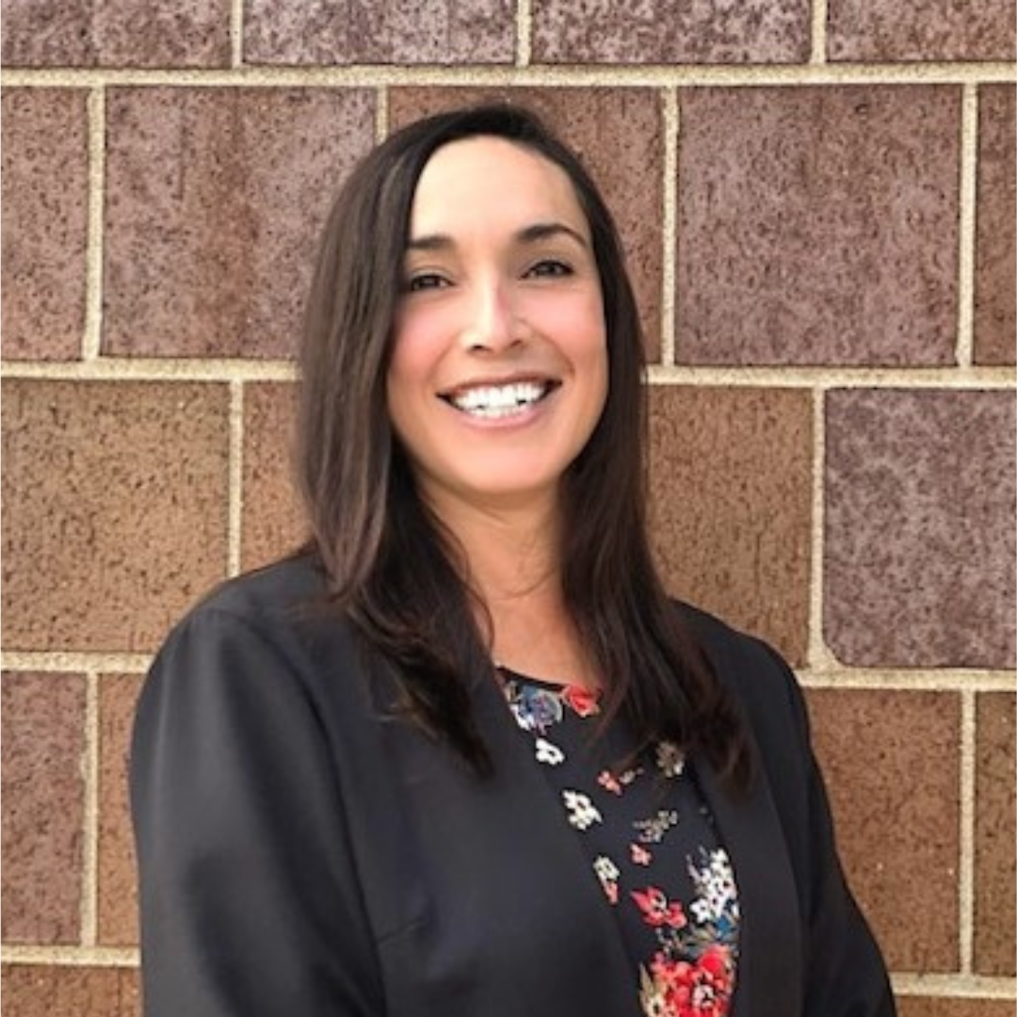
introduction
My name is Sarah Cleveland, Business Services Manager/Apprenticeship Specialist for LWIA 13 serving Rock Island, Henry, and Mercer Counties.
In 2019, I was hired as both the Project Manager for the Innovation Project for Returning Citizens and Executive Assistant. I later became the Board Functions Administrator and am the Business Services Manager today. Six months into my employment, COVID-19 changed my role. At that point, our Executive Director had me applying for and implementing disaster related grants to aid businesses. With the shift brought on by COVID, our business services department began to revitalize. By November of 2020, I implemented the first Incumbent Worker Training (IWT) since 2009.
Prior to Workforce Development, I was employed as a Human Resources Assistant at a Manufacturing Company and later in Management Positions in Long-Term Care.
Why workforce development as a career? I view my work as a community service. Self-sufficient wages and a strong economy positively affects the entire community.
Our local area is a part of the Economic Development Region 6. Our regional partner is LWIA 4. Our area’s target industries are Manufacturing, Transportation, Agriculture, Health, Professional and Business Services, Construction, IT, Self-Employed, and Leisure/Hospitality.
High Impact Industries: Manufacturing, Health, Professional and Business Services (including IT), and Construction

Slide 5
Why apprenticeship?
The Employer Case for Apprenticeship
Hello __________:
My name is Sarah, Business Services Manager with American Job Center. We are a workforce development agency serving Henry, Mercer, and Rock Island Counties. As you likely know, __________ High School has announced the hiring of ________ as Automotive Instructor. I’m reaching out today to gauge if _____________would have interest in discussing programs available to assist with tapping into this potential pipeline of automotive mechanics.
If you have any interest in connecting, please let me know and we can get a meeting scheduled.
Thank you for your consideration,
I’m reaching out to gauge if XXXXX C.U.S.D. would have interest in learning more about K-12 Educator Department of Labor Apprenticeship Programs. As you likely know, ISBE has partnered with Department of Labor’s Office of Apprenticeships, IL Department of Commerce and Economic Opportunity (DCEO), Institute of Higher Education (IHE), and National Center for Teacher Residencies (NCTR) to develop an apprenticeship model for K-12 educators. This model is designed to upskill the district’s selected Paraprofessionals to K-12 Educators, which could lead to a sustainable pipeline of teachers within the district.
American Job Center currently has a program that allows me to act as an apprenticeship specialist. This means that I would be able to do much of the leg work, should the district wish to take a deeper dive into K-12 Educator Apprenticeships.
I’m eager to take a deeper dive into this model of apprenticeships and would like to start here in Henry County. If you have any interest in connecting, please let me know and we can get a meeting scheduled.
Thank you for your consideration,

Slide 6
Why apprenticeship?
The Employer Case for Apprenticeship
When Apprenticeship appears to be a good fit:
Emphasize intentional training. Apprenticeships are an education that organically strengthens the bond between curriculum and hands on work.
Talent pipeline management and succession planning.
Competencies are a guide to achieving skills gain.
High percentage rate for employee retention.
Related training providers and the flexibility of our community colleges.
Program funding assistance through WIOA, APIL, and other tax credits. And….
Discuss creating a sustainable training program, independent from grant funding assistance.
I discuss the ROI of $144.30 in benefits for every $100 spent.

Slide 7
Meaningful Employer engagement
Reaching Employers:
Referrals:
Referrals are by far the best connection to a business. Our Local Area is a blue-collar community, so Quad City Chamber of Commerce and IMEC are my largest referral sources. Referrals are great because a conversation has already taken place where workforce development needs have been identified. This makes an easy transition for me as I can study up on the company, occupations, and the identified need before having that first conversation.
Cold Calls:
LWIA 13 does conduct some ‘cold call’ outreach. As mentioned before, these typically stem from hearing or reading information about the business that I feel would benefit from workforce development guidance and assistance.
Events:
Our local area conducts stakeholder events and participates in events to get our agency well known in the community. Although this is good in practice, events are not as successful at achieving a 1:1 conversation with a business.

Slide 8
Meaningful Employer engagement
Best Practices:
Building and keeping relationships with businesses:
Relationship Building with Partners and Stakeholders
Relationship Building with Businesses
  Research
  Listen- Fluid reasoning
  Empathy
  Follow up
  Follow Through
Lead the Initiative

Slide 9
Meaningful Employer engagement
Best Practices:
Using a checklist with the business to keep us on track:
Review Occupation/Job Description
Identify the related training instruction requirements, begin identifying related training providers. Including costs and location.
Review and edit the work process schedule
Review of wages/ wage schedule
Submit Appendix A to Department of Labor

Slide 10
Meaningful Employer engagement
This chart shows business service activities for the last two months. Currently, Apprenticeship work is the majority of services provided in the area.

Slide 11
Programs in progress
Active Registered Apprenticeship Programs
Community Services, Childcare/Pre-School, Rock Island County:
  Registered Apprenticeship Program in Early Childhood Education with a ladder from Gateways 4 to Gateways 5 (associates to bachelor’s).
  Agency will act as sponsor to additional childcare/pre-school entities.
  Collaboration included:
    University of Illinois Chicago (program guidance),
    Western Illinois University (RTI),
    Black Hawk College (RTI),
    Early Childhood Workforce Connectors (program implementation),
    Department of Labor (Standards)
Manufacturer, Rock Island County:
  Registered Apprenticeship Program in Tool and Die RAP
  Facility Size: 24 employees
  Collaboration with Easter Iowa Community College (sponsor)
  Three apprentices enrolled to date.
  Referred to IDES WorkShare and DCEO EDGE Tax Credit
Manufacturer, Rock Island County:
  Facility Size: 126
  Registered Apprenticeship Program
    Maintenance Mechanic
    Tool and Die
  Collaboration with Eastern Iowa Community College, sponsor

Slide 12
Programs in progress
Active Registered Apprenticeship Programs:
Community Services, Childcare/Pre-school, Rock Island
  Collaboration: Community Services Executive Director, University of Illinois Chicago, United Township (UT) High School, Rock Island.
  Initial meeting held related to Incumbent Worker Training for Apprentices.
  The conversation led to talent pipeline management. The Executive Director explained that the agency has multiple classrooms closed due to the lack of qualified employees. We explored the idea of developing a pre-apprenticeship for High School students.
  UT High School has an early childhood education program that is designed to build a student’s portfolio so that they are prepared and eligible to test for the Child Development Associate Certification. Upon graduation the student is eligible to take the examination for Child Development Associate credential (CDA), which is an entry level requirement for the Pre-School.
  The group identified that upon graduation most students did not move forward with taking the exam, and did not follow through with the career pathway.
    Barriers identified: guidance/mentorship from UT instructor ended upon graduation, cost of CDA examination is $400
    Barrier Reduction: Developed a pre-apprenticeship model that starts Junior or Senior year of High School. Upon graduation, the worksite will continue to provide guidance to pre-apprentices to complete the CDA exam. American Job Center will assist with the cost of the examination through APIL. Once the Pre-Apprenticeship requirements are completed, graduates will receive direct entry into the Early Childhood Education RAP.

Slide 13
Programs in progress
Early Childhood Education Pre-Apprenticeship Framework
Approved Curriculum
  The Pre-Apprenticeship RTI will be provided by United Township High School and will adopt the current early childhood education program’s curriculum. UT’s program is designed to build a student’s portfolio so that they are prepared and eligible to test for the Child Development Associate Certification upon graduation, or shorty after.
  Credentials: CPR/First Aid and Child Development Associate Certification (CDA), Gateway Level 1 credential.
Simulated Experience
  Program will provide observation and hands-on work experience 3-4 hours a week for a total of 80-120 hours.
Facilitated Entry
  Childcare Facility will sign an agreement that allows the program participants direct entry into their ECE RAP, upon successful completion of the pre-apprenticeship program, including program credential attainment.
Supportive Services
  Wrap-Around Services and/or referrals to help participants complete the program.
    Identified barriers include transportation, clothing, the cost associated with program credentials.
Sustainable Partnerships
  SAL agrees that this is a community initiative and will refer students who chose not to participate in the pre-apprenticeship model to other alternative childcare providers through CCRR.

Slide 14
Programs in progress
Registered Apprenticeship Programs in Development:
Agriculture, Henry County, IL – Development Stage
  Expanding Diesel Tech RAP to serve other locations. LWIA 13 Serves Henry County Facility.
  Current RAP RTI at Parkland College, Champaign
  Expanded Related Training Instruction: Black Hawk College (BHC) is reviewing Appendix A to Automotive Tech and Ag Tech Curriculum. Other options: Scott Community College in QC, IA
  Additional RAPs interested in expanding: Management in Service and Parts.
  Roadblocks
  Company would like BHC to provide RTI. BHC is unsure if they have the applicable coursework. In process.
Automotive Dealership, Henry County– Development Stage
  RAP Automotive Technician
    RTI
      Universal Technical Institute (UTI), Lisle, IL: will use for first cohort
      Black Hawk College- will work with BHC to explore needed instruction/curriculum.
  ISBE College and Career Pathway Endorsement- Automotive Tech at High School
    The business has met with the local High School and has agreed to be the WBL site for the career endorsement program.
    The High School Instructor is working with Automotive Dealership to identify the most useful curriculum for the course.
    LWIA 13 Developed pre-apprenticeship model that enrolls High School Automotive Tech students participating in the College and Career Pathway Endorsement program. Upon completion of endorsement and WBL hours the graduate will be offered direct entry into the RAP.

Slide 15
Programs in progress
Registered Apprenticeship Programs in Development:
School District, Henry County, IL – exploratory Stage
  College and Career Pathway Endorsement- Education
  Two 2025 Seniors identified as potential “grow your own” Educators within the district
  Related Training Instructor: ISBE approved McKendree University
  Developed Pre-Apprenticeship Framework for direct entry into RAP Educator K-6 at 60 credit hours.
  Roadblocks
  Western Governors University is the most enrolled IHE for paraprofessionals within this district. Tuition at this University is less per credit hour than McKendree University.
  Benefits
  Eliminating the concept of 1st year teacher.
  McKendree completes the administrative requirements related to the apprenticeship.
  McKendree completes the administrative requirements for apprentice licensing post completion. According to ISBE, this reduces the wait time for approval.
  Grow Your Own model will build a long-term pipeline to fill Educator vacancies.

Slide 16
Programs in progress
Educator Pre-Apprenticeship Framework
Approved Curriculum
  Educators Rising: ParaPro assessments with curriculum;
  Black Hawk College general studies program curriculum, which is designed to build a student’s skills to be applied to many different careers.
  Pre-Apprentices will be required to test for the Paraprofessional Licensure by receiving a 460 or above on the test.
    Credentials Earned: Associate degree; Paraprofessional Licensure
Simulated Experience
  Program will provide observation and hands-on work experience. Work Experience will be flexible to the pre-apprentice’s school schedule. Minimum hours of work experience per week is _(enter number of hours)_______.
Facilitated Entry
  Upon successful completion of the pre-apprenticeship program, including program credential attainment, ____(enter school district)________ will provide the pre-apprentice with an acceptance letter that provides direct entry into their K-6 Educator RAP.
Supportive Services
  Wrap-around services and/or referrals to assist with the pre-apprentice’s successful completion of the training program.
    Identified barriers may include transportation, clothing, the cost associated with program credentials.
    Identified referral agencies: American Job Center
Sustainable Partnerships
  The pre-apprenticeship model will provide sustainable partnerships between ____________ School District, American Job Center, Department of Labor, __(enter community college)___, and ____(enter IHE with ISBE approved RAP)____.

Slide 17
Programs in progress
Active Pre-Apprenticeship Programs:
Kewanee Life Skills Re-Entry Center Building and Construction Trades Work-Based Learning Pre-Apprenticeship
Cohort
  Eight Participants
    MSR range: 11/1/2025-3/31/2026
    Permanent Party strongly discouraged
  26-week program
  April 7 – October 10, 2025
  Monday-Friday, 6 hours a day
  Three days a week of work-based learning
  Two days a week of in-class and hands-on training
Approved Curriculum
  This program is designed to build a participant’s knowledge and entry level skills in the building and construction occupations. The program will implement curriculum designed to incorporate industry standards:
    Introduction to Building and Construction Trades
    Introduction to Hand and Power Tools
    Blueprint Reading
    Construction Math
    *OSHA 10
    Basic Employability Skills
    Test Taking Skills
    Basic Safety
    *Union Presentations
*OSHA 10 and Union Presentations is a possibility, dependent on 3rd party instructor and union availability and KLS approval.
3. Simulated Experience
  Program will provide in-class lecture, observation, hands-on learning, and work-based learning elements.
    Work-based learning: 18 hours a week
    In-class and hands-on training: 12 hours a week
4. Facilitated Entry
  Participants will receive career services aimed at entry into a DOL Registered Apprenticeship program in the building and construction trades. Services include: resume building, mock interviews, job searching, assistance with applying to DOL Registered Apprenticeship Programs, and referrals to their local WIOA office.
  Rock Island Tri-County Consortium staff will provide 12 months of follow up services to each participant.
5. Supportive Services
  All participants will be eligible to receive supportive services, barrier reduction services and/or referrals to assist in program completion and transition to employment post-release.
6. Sustainable Partnerships
  City of Galva
  Ron Peterson- Instructor
  Kewanee Life Skills
  Rock Island Tri-County Consortium/American Job Center
  Building and Construction Training Centers-Union and Non-Union
  Department of Commerce and Economic Opportunity, IL Works
  Department of Commerce & Economic Opportunity, Employment & Training Administration

Slide 18
Collaborations & Partnerships In action

Slide 19
Collaborations & Partnerships In action
Chamber of Commerce
Kewanee Chamber of Commerce
Geneseo Chamber of Commerce
Quad Cities Chamber of Commerce
Economic Development
Rock Island County
Henry County
Kewanee Economic Development
Secondary Education:
Kewanee High School
Geneseo High School
Rock Island-Milan High School
Core and Required Partners
The Arc of the Quad Cities Area
Illinois Department of Human Services
Project NOW, Inc.
National Asian Pacific Center on Aging
Governmental Entities:
City of Kewanee- City Manager
City of Galva- City Administrator
Department of Commerce and Economic Opportunity
Kewanee Life Skills Re-Entry Center
Illinois State Board of Education (ISBE)
Post-Secondary Education:
McKendree University
Western Illinois University
Easter Iowa Community College
Community Based Organizations:
Safer Foundation
YWCA-Rock Island
Union Organizations:
IBEW Local 145
Carpenters Union Local 4
Ironworkers Union Local 111
Laborer’s Union Local 309
Millwright’s Union Local 2158
Bricklayers Local
Masonry Local
IUPAT Local 81
OPCMIA Local 18
Sheet Metal Workers, Local 91
Plumbers & Pipefitters Local 25
Apprenticeship Expansion Support Entities:
Safal Partners
Early Childhood Workforce Connectors
University of Illinois Chicago

Slide 20
Funding innovations
  Incentives:
    Cost of Related Training Instruction
    Costs related to on-the-job training
    Laptops for Sponsor to loan to apprentices
  Supportive Services
    Costs related to apprentice tools
    Costs related to testing/credential attainment

Slide 21
Challenges faced
  Local Economy.
  Financial Resources for sustainable projects.
  Misconception of what it takes to implement a RAP.
  Lack of Intermediary within the three-county area.
  Related Training Instruction.
  Time/Capacity of a Business.

Slide 22
Effective approaches & Future Goals
Effective Approach
Building relationships.
Future goals
College and Career Endorsement Pathway: I’m enjoying bridging the High School College and Career Endorsement Pathway program into the communities. Since this is a State initiative, I believe focusing on supporting the development of pre-apprenticeship bridges to apprenticeships is a worthwhile goal.
Related Training Instruction (RTI): Finding Related Training Instruction is not always attainable. I would like to guide a business through the steps of holding the RTI in house.

Slide 23

\
Q&A
Feel free to unmute or drop your questions in the chat!

Slide 24
Contact us:
  LWIA #13 Team:
  Sarah Cleveland Sarah.Cleveland@AmericanJob.Center
  APIL Team:
  Nate Carlson ncarlson@niu.edu
  Jordan Johnson jtjohns@ilstu.edu
  Jennifer Foil, Ph.D. jfoil@niu.edu

